Slide 1

VANGUARD
A/B TEST
Alex Krc
Mateo Mariaca
08.05.2024

Slide 2






VANGUARD
A/B TEST
Alex Krc
Mateo Mariaca
08.05.2024

Slide 3
INTRODUCTION
PROJECT OVERVIEW
VANGUARD
A/B TEST

Slide 4
PROJECT OVERVIEW
Objective: Analyse if the new UI is better
Data has to be reliable
Define KPI’s
Statistic significance for reliability of the sample/test
Answer: Is the completion rate higher with a new Web Design?
VANGUARD
A/B TEST

Slide 5

EDA – Understanding & Cleaning
4 Datasets:
Client Profiles
VANGUARD
A/B TEST
2 Digital Footprints
Experiment Roster
Notes:
First part of the EDA:
We were presented with 4 different data sets.

Slide 6
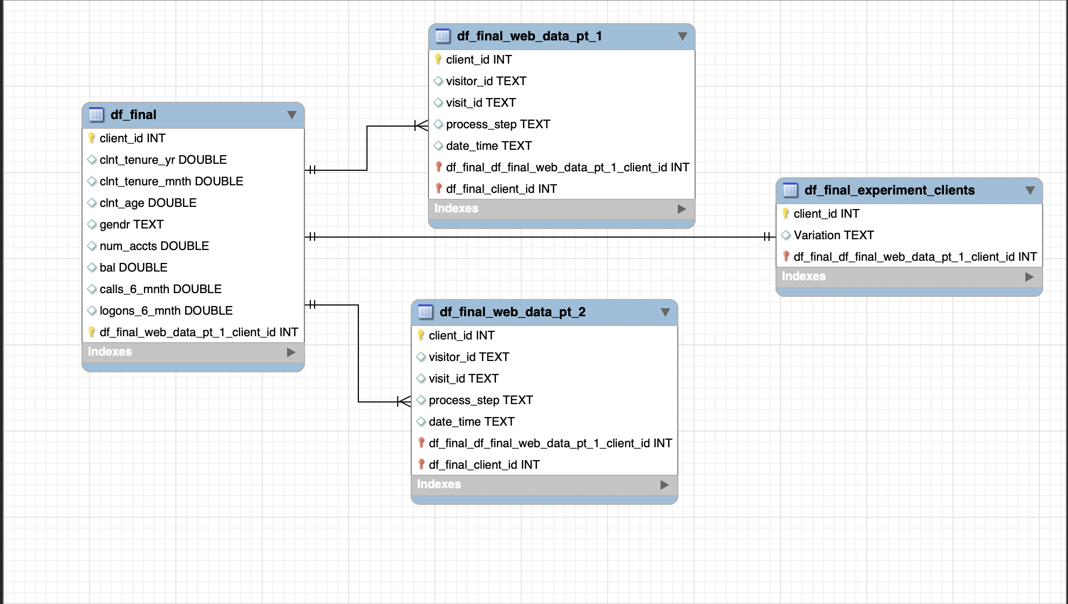
VANGUARD
A/B TEST
Notes:
We can see here their realationship:
- The client profiles dataset came with the information on the clients and the different demographics: Age, gender, wealth and years or months as a customer.
- The 2 digital footprints gave us the information on the behavior in the web by the different clients. Like time spent, steps taken
- And finaly the 3rd dataset which gave us the information fi the client was in the control group: so was using an old version of the web or was in the test group, using the new desing of the web
Luckyly the data was pretty clean aside from some null values in the client profiles data set which we just puted aside and also the where client_id‘s that where not part of the variation dataset and therefore where not part of the experiment. However they could give us important information on the behavior of customers before the experiment. Or overall.

Slide 7
EDA – Demographics
Primary clients:
People in their 20’s
Avg balance account of 51K
Tenure Year: 5
Gender: Unidentified
VANGUARD
A/B TEST

Slide 8
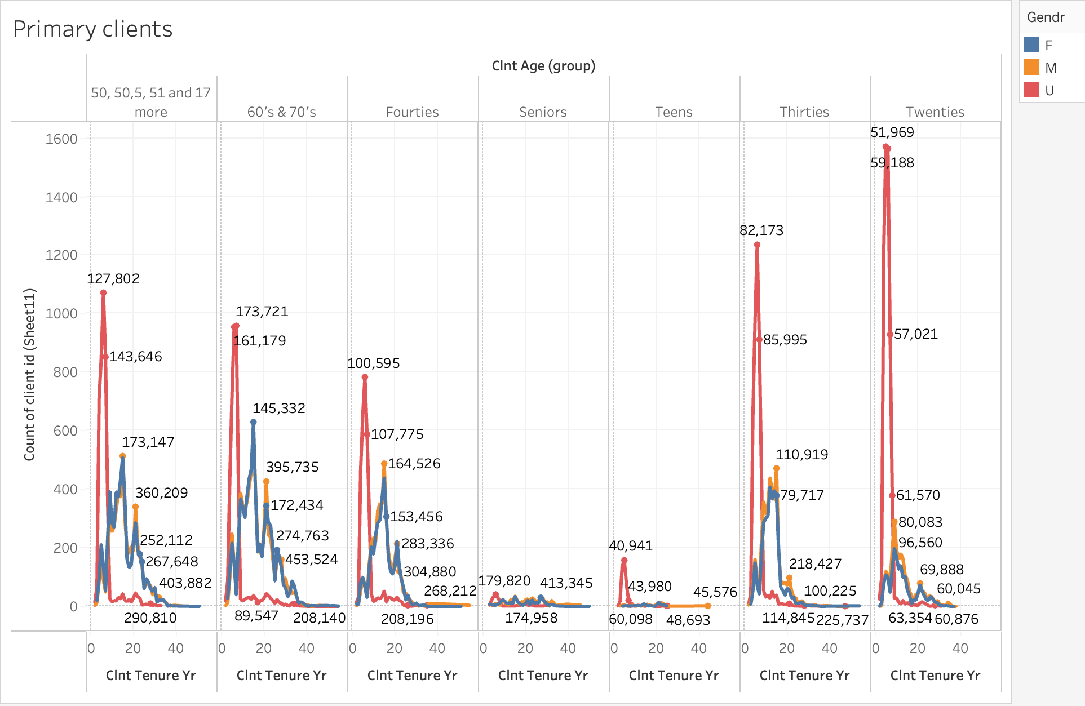
VANGUARD
A/B TEST

Slide 9
EDA – Demographics
EDA – Behavioral Analysis
VANGUARD
A/B TEST
Further exploration later with tableau
Notes:
Another key side of our EDA is the behavioral analysis however before we dive into this ist important to understand the KPI‘s we defined for our study so we are going to explore

Slide 10


Key Performance Indicators
Completion rate
VANGUARD
A/B TEST
Time to completion
Error Rates
Tenure
Notes:
What are KPI? Well as the name already states it, are key performnce indicators that are going to serve us as a measurment to decide if our experiment is going good or bad
We defined the following for our experiment:

Slide 11
Key Performance Indicators
Control
Test
Completion rate
46%
56%
VANGUARD
A/B TEST
Total Completion time
160s
168s
Error Rates
18%
28%
Median Bal.
F: 69K
T: 63K
F: 67K
T: 64K
Notes:
We found outt that:
And we are goiung to explore more with some graphs later in tableau.
So having defined our KPI‘s we want to set the objective of our design. And we do this with the help of the hypothesis testing….

Slide 12
Hypothesis Testing
H0 = ?
H1= ?
VANGUARD
A/B TEST
Notes:
We have to denife our hypothesis for the whole project. So basically the final objective.

Slide 13
Hypothesis Testing
H0 - There is no significant difference in user behavior/performance between the Control and the Test group.
H1 - There is a significant difference in user behavior/performance between the Control and the Test group.
VANGUARD
A/B TEST
Notes:
The aim of these research is to see if the new design is better than the old one. However in order to do this we have to work with our defined KPI‘s. Therefore we are going to see our test….

Slide 14
Hypothesis Testing
A/B Test
Total sample:
n= 50.500
VANGUARD
A/B TEST
Control group
Test group
Control group:
32.243
Test group:
= 37.204
Notes:
Upon cleaning and combining the data obtained from running the test, we narrowed it down to 50’500 individual data points to work on.
The data was grouped per every combination of client ID, visitor ID and visit ID so that we could observe every individual customer behavior from every time they visit the webpage.
Now giving these sample we define a more contrete Hypothesis…..

Slide 15


Hypothesis Testing
H0 - There is no difference between the completion rates of the old and new website design
H1 - The new design has a higher completion rate
Statistical significance with
VANGUARD
A/B TEST
Test for completion rate between
Test & Control group
= 0,05
P-Value
= 1,77x10^-112
Notes:
Since we compared 2 categorical values, we decided to use the Chi Squared test.
After running the test, we got the Chi Square parameter and it‘s P-Value. Since the P value is less than our given threshhold alpha = 0,5, we conclude that
Given our H0 Hypothesis, we have significant evidence to reject our H0 hypothesis. So that the completion rate of the new design is significantly different than the completion rate of the old design.

Slide 16
Hypothesis Testing
Statistical significance with
T
Average time to completion between Control and Test group
VANGUARD
A/B TEST
H0 - Avg. Completion rate between groups is the same
H1 – Avg. Completion rate is different between the 2 groups
= 0,05
P-Value
= 1,84x10^-16
T
= -8,23

Slide 17
Tableau
VANGUARD
A/B TEST

Slide 18

Experiment Evaluation
Sample was randomly and equaly picked?
Yes (if total users)
Yes
Were there any biases?
- Yes (in favor of the new webpage)
Time Frame:
Too short for an experiment (Seasonality effect or others)
Additional Data:
-Info about the specific changes and what a step means
-Relevance of the different devices
VANGUARD
A/B TEST

Slide 19
Experiment Evaluation
Difference in the behavior based on the demographics:
VANGUARD
A/B TEST
Gender
Age
Wealth
Tenure

Slide 20
Challenges & learnings
Reading the instructions
Understanding and manipulating data
Working with Tableau
VANGUARD
A/B TEST

Slide 21
VANGUARD A/B TEST
Conclusion
The new UI is statistically better than the old version in terms of completion rate.
However the time spent and error rate are higher on average, which is something that Vanguard wanted to reduce.

Slide 22
THANK YOU
Alex Krc
Mateo Mariaca

